Slide 1
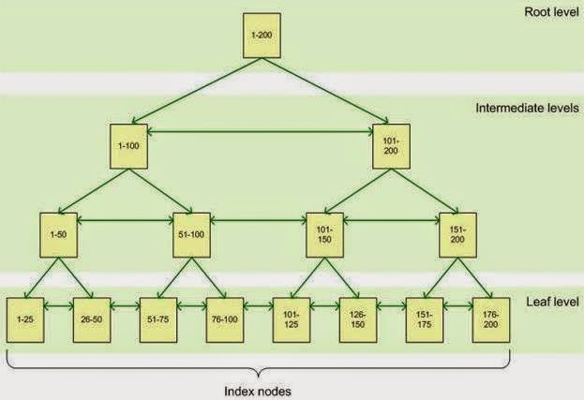
200
ROOT
NON CLUSTERED
INDEX ON FN SORTED
INTERMEDIATE
LEVEL
1-100
100 -200
LEAF LEVEL
CONTAINS THE NON CLUSTERED INDEX OF FIRST NAME AND POINTER TO CLUSTERED INDEX ID
1- BOB
50 - TOM
51- MARY
100 - SUE
101- DON
150 - JON
151- AVA
200 - LEO
CLUSTERED INDEX ON ID SORTED
THE LEAF LEVEL OF THE CLUSTERED INDEX CONTAINS THE ACTAUL DATA

